Slide 1
Multimedia Computing
By
Minhaz Uddin Ahmed, PhD
Department of Computer Engineering
Inha University Tashkent.
Email: minhaz.ahmed@gmail.com

Slide 2
Content
Image types
LOOK-UP Tables
Contrast Stretching
Intensity Transformation
Histogram Equalization
Histogram Specification
Arithmetic Operations
Logic Operations

Slide 3
Types of image
Binary image
Gray scale image
Color image

Slide 4
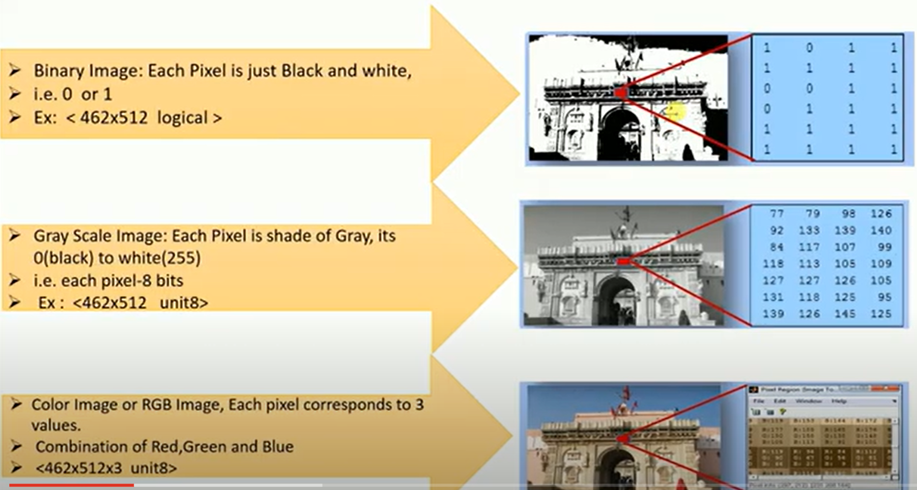
Types of image

Slide 5
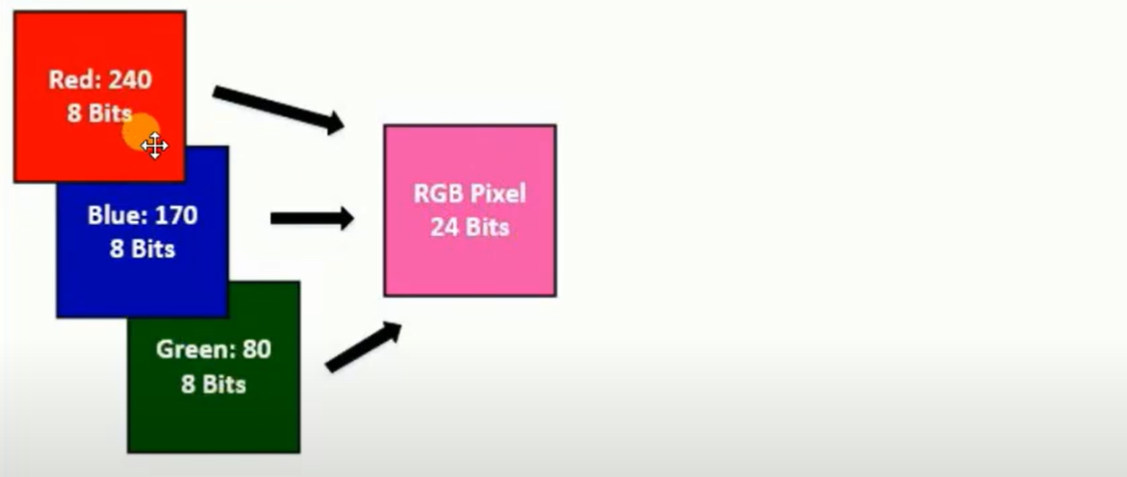
RGB image
An RGB image is essentially three images layered on top of one another; Red , green, blue each pixel in them being 8 bits(intensity value ranges 0-255). To store a single pixel of an RGB need to store 8 bits for all three colors total 24bit per pixel

Slide 6
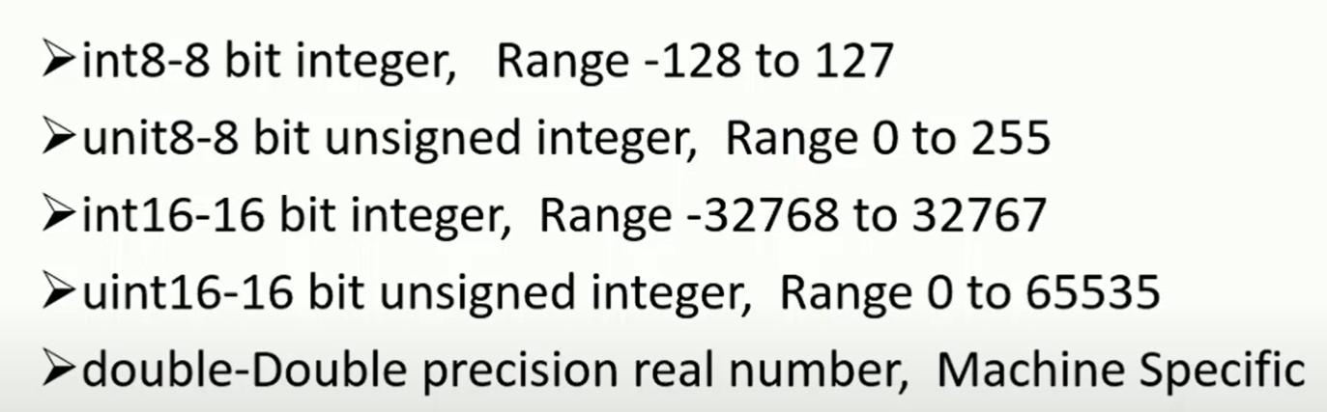
Image Data type

Slide 7
Point processes
Point processes :
  The simplest of the basic image processing operations
  Based solely in the pixel’s value
    Easily implemented as look-up tables
The model of spatial domain methods
  Spatial domain point processing: operate directly in the aggregate of pixels.

Slide 8
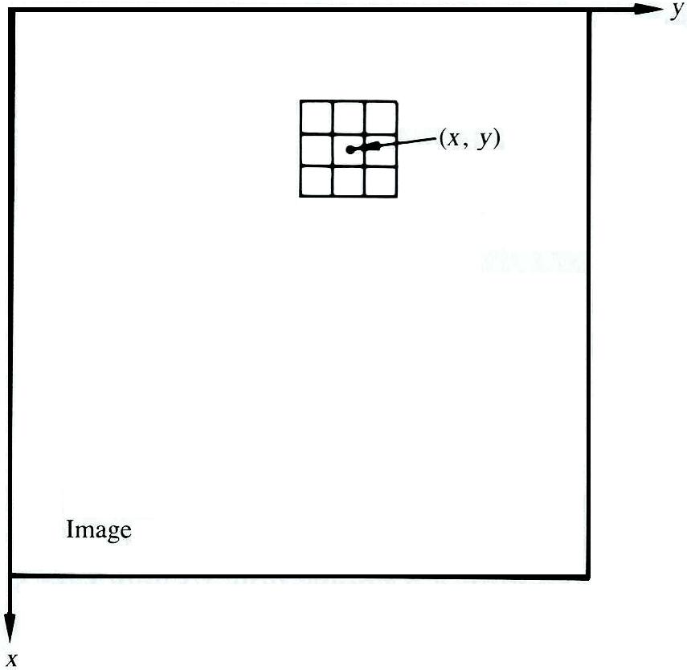
Spatial domain methods
The model for image processing
Let T be an operator in f defined over some neighborhood of (x,y) or a set of input image
g(x,y) = T[f(x,y)]
  g(x,y): processed image
  f(x,y): input image
A3 × 3 neighborhood about a point (x,y) in an image [Gonzalez]

Slide 9
Look-up Table (LUT)
An LUT is simply a table of cross-references linking index numbers to output values. The most common use is to determine the colors and intensity values with which a particular image will be displayed, and in this context the LUT is often called simply a colormap.
The idea behind the colormap is that instead of storing a definite color for each pixel in an image, for instance in 24-bit RGB format, each pixel's value is instead treated as an index number into the colormap. When the image is to be displayed or otherwise processed, the colormap is used to look up the actual colors corresponding to each index number. Typically, the output values stored in the LUT would be RGB color values.
There are two main advantages to doing things this way. Firstly, the index number can be made to use fewer bits than the output value in order to save storage space. For instance an 8-bit index number can be used to look up a 24-bit RGB color value in the LUT. Since only the 8-bit index number needs to be stored for each pixel, 8-bit color images take up less space than a full 24-bit image of the same size.

Slide 10
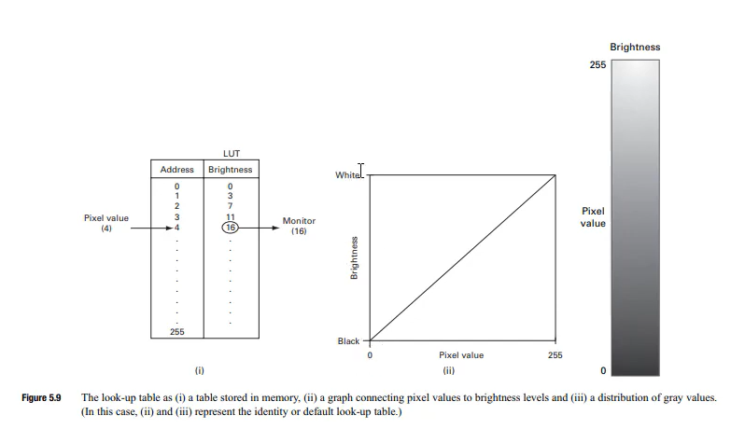
Look-up Table (LUT)

Slide 11
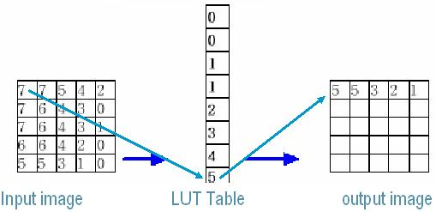
Look-up Table (LUT)
LOOK-UP Tables
  use the current pixel value as the array index → simple arrays
  new value is the array element pointed by this index
Operation of a 3-bit look-up table.

Slide 12
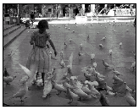
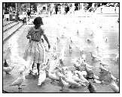
Look-up Table (LUT)
LOOK-UP Tables
Original image
Output image after LUT

Slide 13
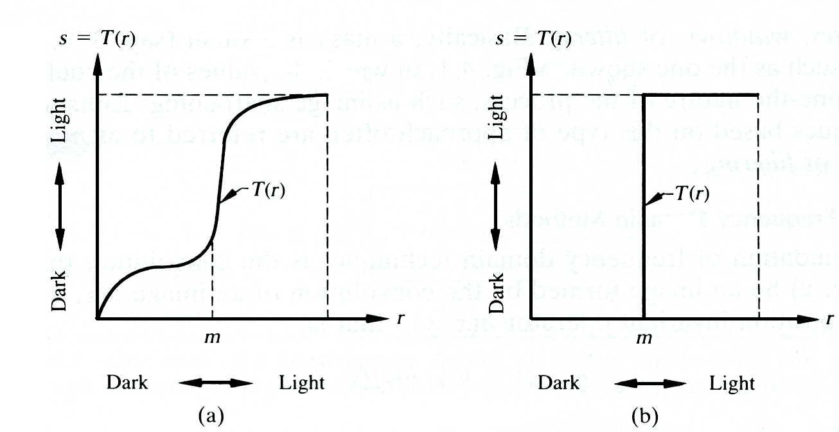
The model of point processing
Point processing: the simplest form of T
  1 x 1 neighbor
  g depends on only on the value of f at (x,y)
  Gray-level transformation(or mapping)
    s = T(r)
    s(processed image): the gray level of the g(x,y)
    r(input image): the gray level of the f(x,y)
Fig. Gray-level transformation for contrast enhancement [Gonzalez]: (a) the effect is contrast stretching, and (b) binarization.

Slide 14

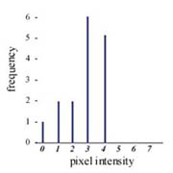
Histogram
Histogram
  A simple bar graph that stands for pixel intensities.
    The pixel intensities are plotted along the x-axis and the number of occurrences for each intensity are plotted along the y-axis.
    Provide information about contrast and overall intensity distribution of an image

Slide 15
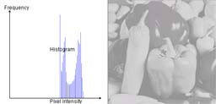
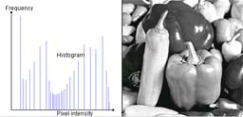
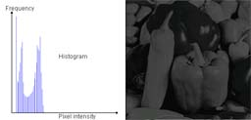
Histogram

Slide 16
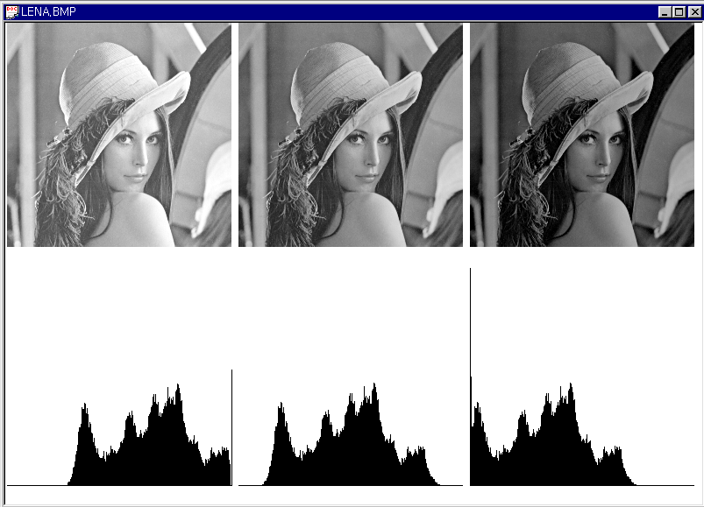
Histogram
Original Image + 40
Original Image
Original Image - 40

Slide 17
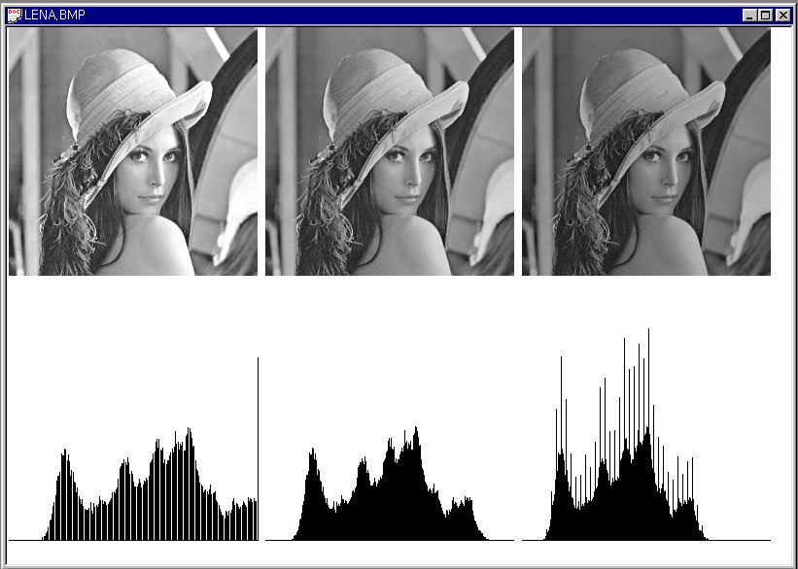
Histogram
Original Image * 1.2
Original Image
Original Image / 1.2

Slide 18
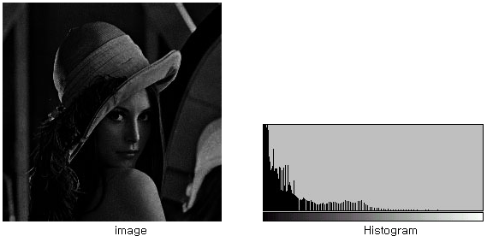
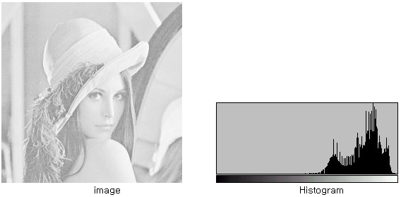
Histogram

Slide 19
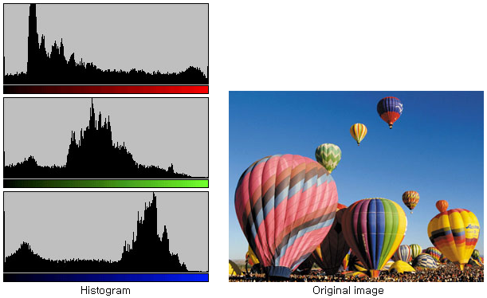
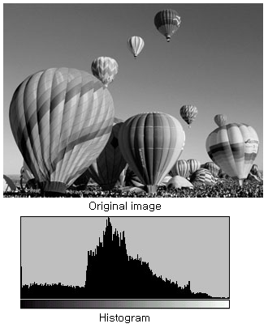
Histogram
Histogram in Gray-level and Color Image
RGB
Gray

Slide 20
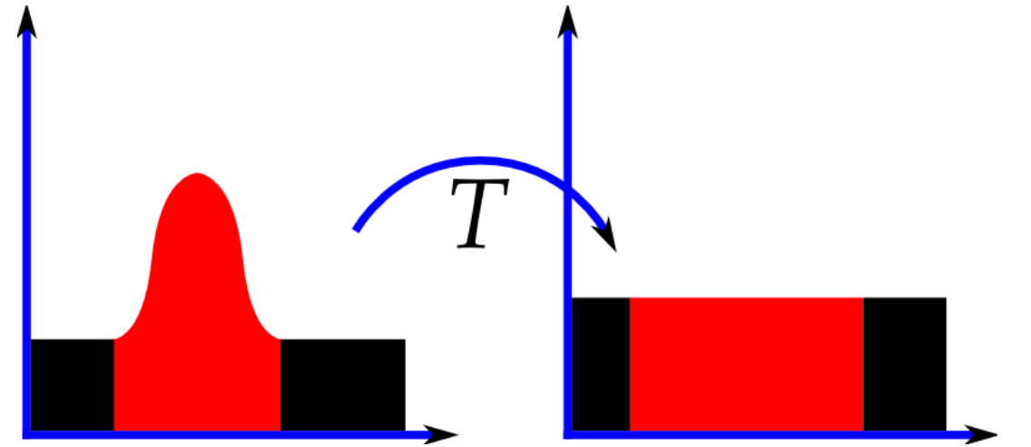
Histogram Equalization
Histogram Equalization
  (Goal) to obtain a uniform histogram for the output image
    Mapping of gray level r into gray level s s.t. the distribution of gray level s is uniform.
    Spreading: the peaks and valleys will be shifted (due to approximation in digitized space)
Histogram Equalization Steps
  Compute histogram.
  Calculate normalized sum of histogram
  Transform input image to output image
Histograms of an image before and after equalization.

Slide 21

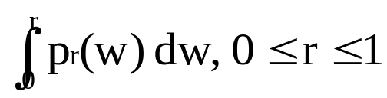



Histogram Equalization
(def)
  r: represent the gray level,
    Pixel values are continuous quantities
    Discrete formulation: allow pixel values to be interval [0, L-1]
  Transform s = T(r) =
    Produce a level s for every pixel value r in the original image
    The transform must satisfies the following conditions
      Condition(a): T(r) is single-values and monotonically increasing in r [0,1]
      Condition(b):
  Inverse transform r = T^{–1}(s), s [0,1]

Slide 22
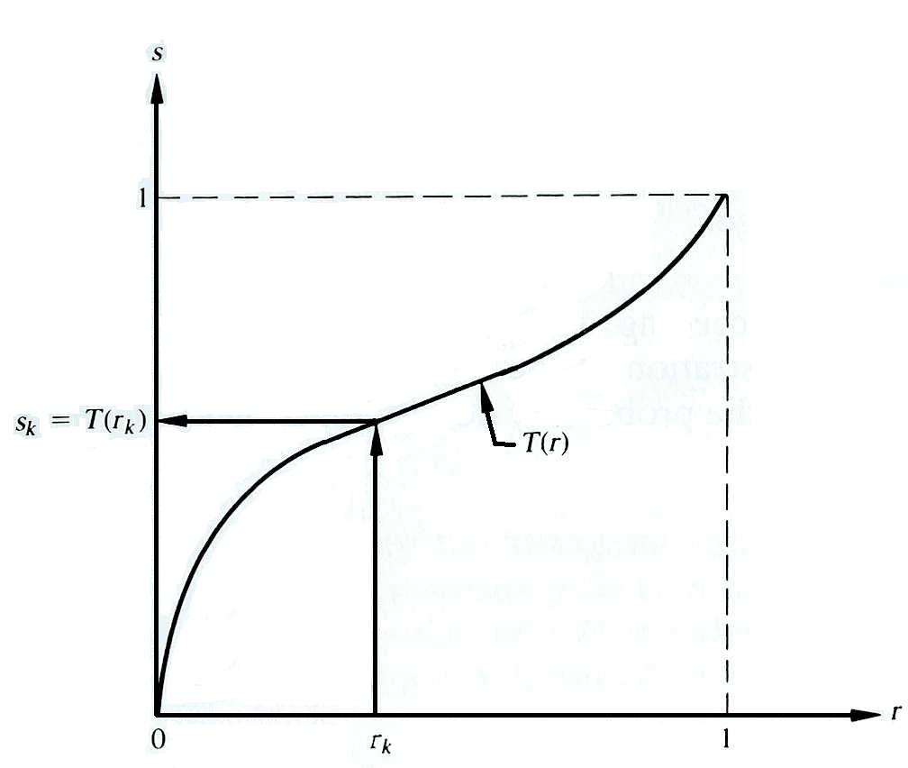
Histogram Equalization
A gray-level transformation function
Fig. A gray-level transformation function. [Gonzalez]

Slide 23
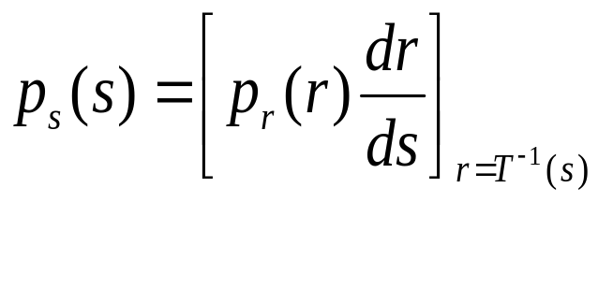
Histogram Equalization
The gray levels may be viewed as random quantities in [0,1]
  Can be characterized by probability density functions
    Original gray levels: p_{r}(r)
    Transformed gray levels: p_{s}(s)
From elementary probability theory,
    If p_{r}(r) and T(r) are known and T^{–1}(s) satisfies condition (a) the probability density function of the transformed gray levels is

Slide 24

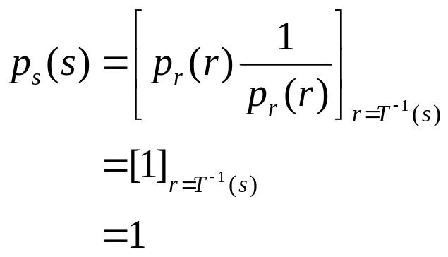
Histogram Equalization
Consider the T(r) with CDF(Cumulative distribution function) of r, i.e.,
  s = T(r) =
Then, = pr(r)
Uniform density of the transformed variables s

Slide 25
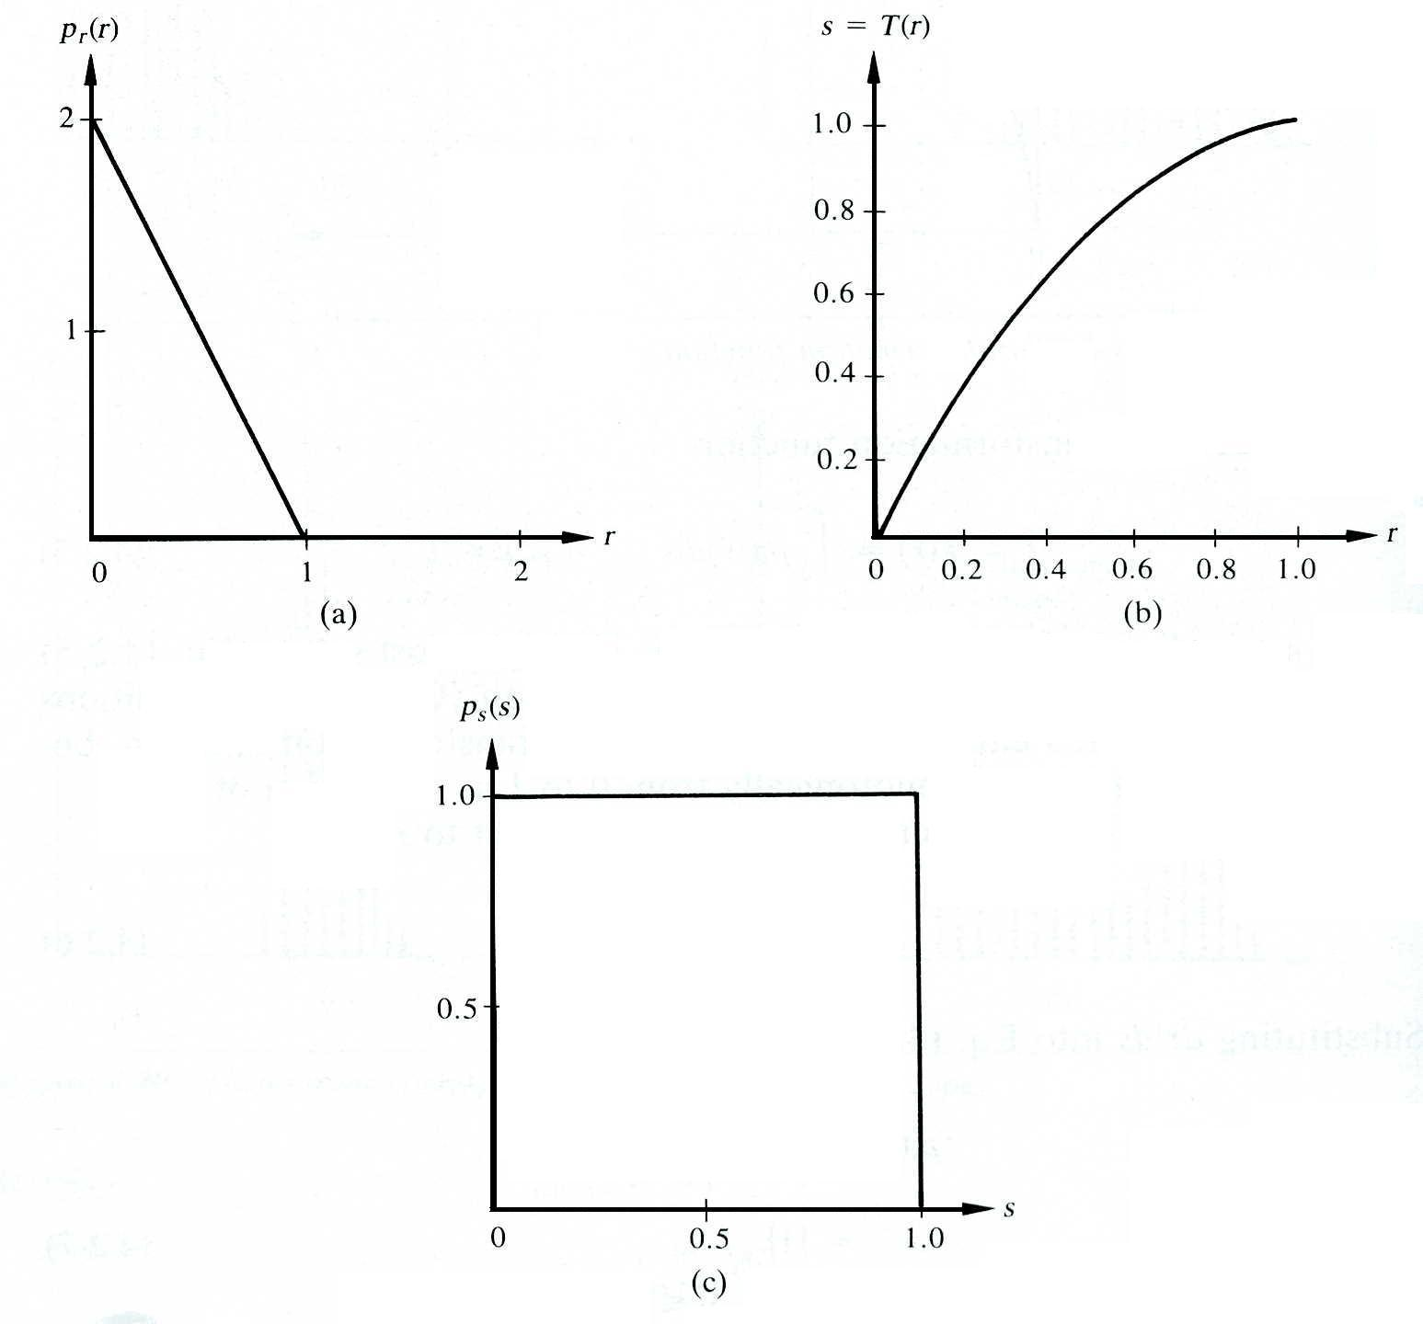
Histogram Equalization
Uniform density transformation method
Fig. Illustration of the uniform density transformation method: (a)original probability density function; (b)transformation function; (c)resulting uniform density [Gonzalez]

Slide 26
Histogram Equalization
The effects of H.E.
    H.E. stretches contrast (expand the range of gray levels) for gray levels near histogram maxima
    Compresses contrast in areas with gray levels near histogram minima.
    Contrast is expanded for the most of the image pixels => H.E. usually improves the detectability of many image features.
    The resulting histogram is not flat
      nothing in the discrete approximation of the continuous result previously derived says that it should be flat.
    Similar effect of enhancement could be achieved by manual contrast stretching approach

Slide 27
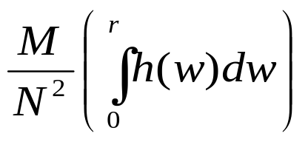
Histogram Equalization
The mapping of H.E.
    To map a small interval of gray level dr onto an interval ds, => g(s)ds = h(r) dr
      h(r): histogram of input image, g(s) : new histogram
    g(s) is to be uniform for H.E., i.e., G(s) = N² / M
      N² : the number of pixels in the image
      M : the number of gray levels
    Then, we have the equation for the normalized cumulative histogram as follows.
      T(r) =

Slide 28
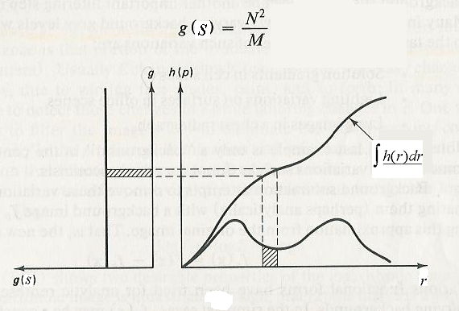
Histogram Equalization
Basis of H.E. [D.H. Ballard]

Slide 29
Histogram Equalization
[Method]
Step 1: Compute histogram

Slide 30
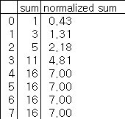
Histogram Equalization
Step 2 : Calculate normalized sum of histogram
1 * (7/16) = 0.43
3 * (7/16) = 1.31
. . .

Slide 31
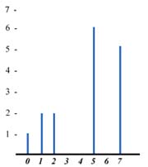

Histogram Equalization
Step 3: Transform input image to output image
Image transform using LUT

Slide 32
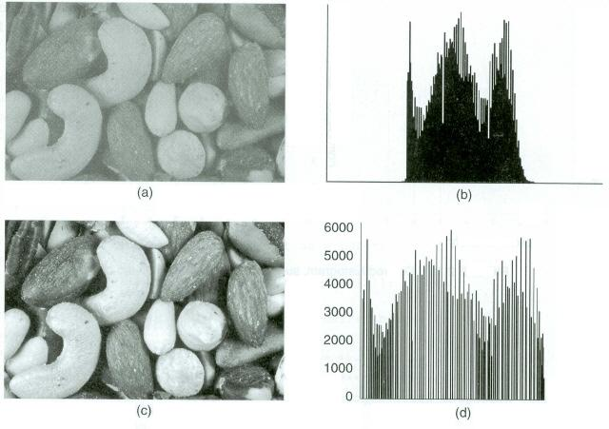
Histogram Equalization
Fig. (a) Original image; (b) histogram of original image; (c) histogram equalized image; (d) histogram of equalized image.

Slide 33
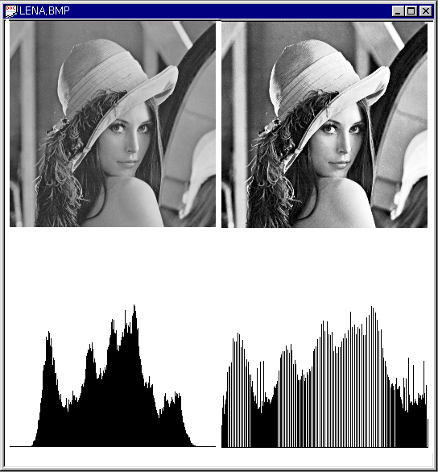
Histogram Equalization
Original Image
Histogram Equalize
Image
Equalization
(256 Level)

Slide 34
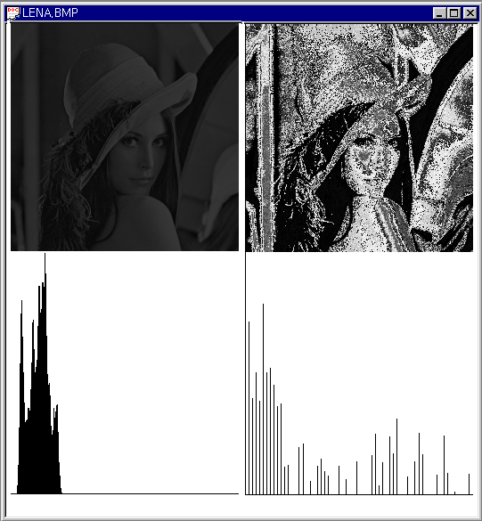
Histogram Equalization
Original Image / 4
Histogram Equalize Image
(64 Level)

Slide 35

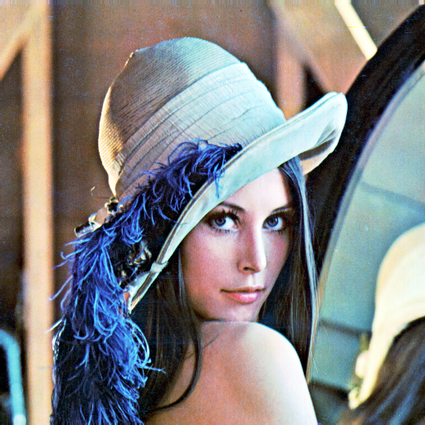
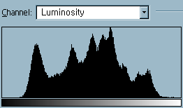
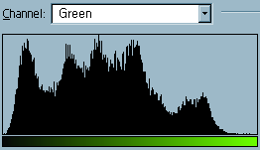
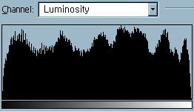
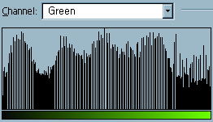
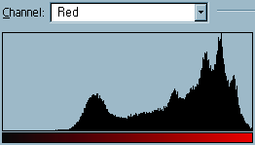
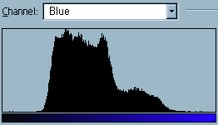
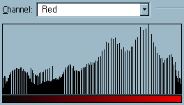
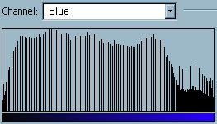
Histogram Equalization
Original Image
Equalized Image

Slide 36
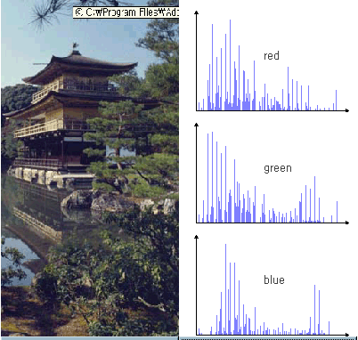
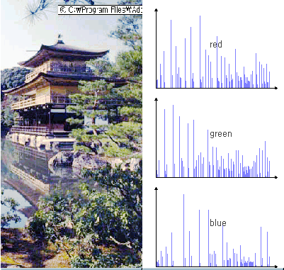
Histogram Equalization
Original Image
Equalized Image

Slide 37
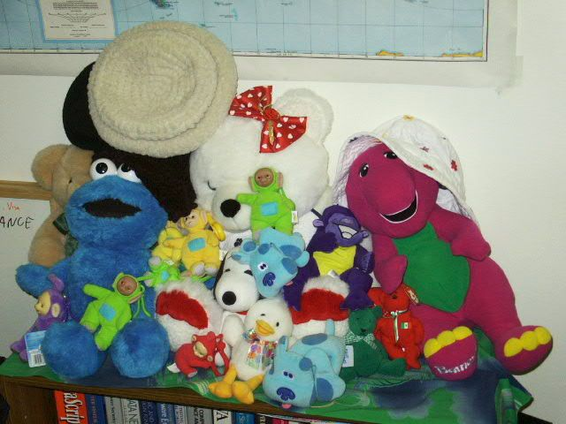

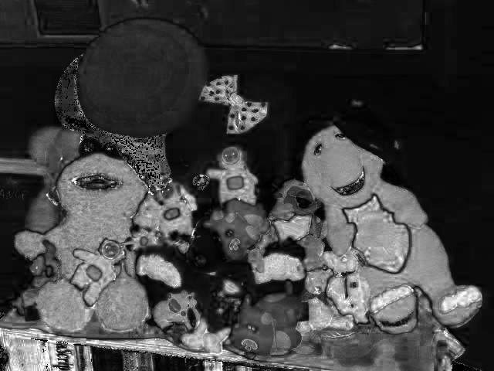
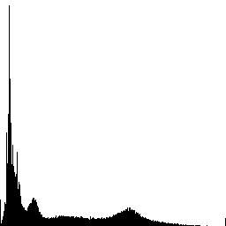
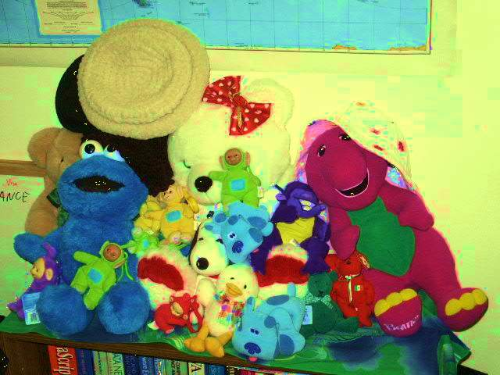

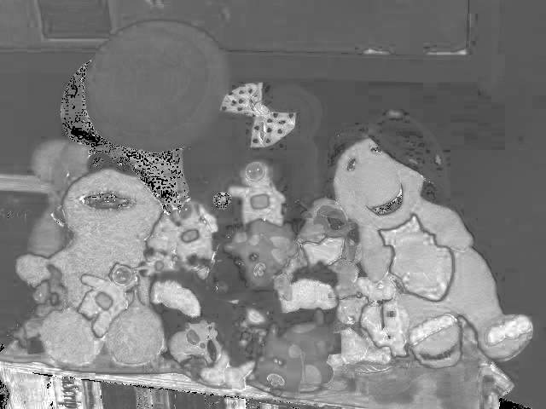
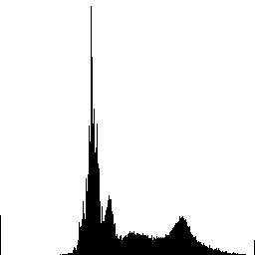
Histogram Equalization
Saturation adjustment function
Saturation image
Saturation histogram
Input / Output

Slide 38
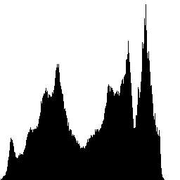


Histogram Equalization
Image
Histogram equalized intensity

Slide 39



Histogram Equalization
Original image
Histogram equalized intensity
Each R, G, B image is histogram equalized

Slide 40
Histogram Specification
Histogram specification
  Specify particular histogram shapes capable of highlighting certain gray-level ranges in an image
  Lighten or darken an image or you need more contrast in an image
  Requires both a desired histogram and the image as input.
The principle difficulty in applying Histogram Specification lies in being able to construct a meaningful histogram
  1. Specify a particular probability density function.
  2. Specify a particular histogram shape by means of graphic device.

Slide 41
Histogram Specification
1.Compute the histogram of both the input image and the target image.
2.Calculate the cumulative distribution function (CDF) of both the input and target histograms.
3.Find the mapping function that relates the input image’s CDF to the target image’s CDF.
4.Apply the mapping to the input image to adjust its pixel intensities, resulting in the transformed image.

Slide 42




Histogram Specification
Let p_{r}(r) and p_{r}(z) be the original and desired probability density functions. Z is the levels of the desired image highlightened certain gray-level ranges
(1) Equalize the levels of the original image
Histogram equalization applying
(2) Specify the desired density function and obtain the transformation function G(z)
  Desired image could be equalized by
(3) Apply the inverse transform function.
  The inverse process

Slide 43

Histogram Specification
Histogram equalize the original image
Perform an inverse histogram equalization on the equalized image
Fig. Block diagram of histogram specification.

Slide 44

Histogram Specification
Histogram specification
Fig. Desired histogram, sum of histogram with mappings, and inverse LUT.

Slide 45

Histogram Specification
Original Image
& Histogram
Desired Histogram
Result Image
& Histogram

Slide 46

Arithmetic operations
Arithmetic operations
  Addition, Subtraction, Division, Multiplication
  Addition & subtraction: adjusting the brightness of the image
    a : random pixel value
  Subtraction : motion detection
  Division, Multiplication : adjust the contrast of the image

Slide 47


Arithmetic operations
Fig. 2.1 (a)Original image; (b)image+40; (c)image-40.
Fig. (a)image*1.2; (b)image/1.2.

Slide 48



Arithmetic Operations
Addition and Subtraction
  Adding values to a pixel brightens the image.
  Subtracting values from a pixel darkens the image.
  Adding and subtracting cannot adjust the contrast of the image.
<Original>
<Original+50>
<Original-60>

Slide 49





Arithmetic operations
add operation
Original image
subtract operation

Slide 50


Arithmetic Operations
Multiplication and Division
  Multiplying and dividing pixels by different values adjust the contrast of the image.
  The contrast of the image will be increased by multiplication and decreased by division.
<Original>
<Original *1.5>
<Original/1.5>

Slide 51



Point processes
Multiplication operation
Original image
Division operation

Slide 52
Arithmetic Operations
Problems
  They can generate negative values or values greater than the maximum possible values.
  One possible solution is clamping. It sets to 0 for negative values and to 255 for overflow values.

Slide 53




Point processes
Image Subtraction and Change Detection
  applications
    medical imaging application : display blood-flow paths
    automated inspection of printed circuits
    security monitoring

Slide 54
Logic operations
NOT operations
XOR operations
  Bitwise XOR(eXclusive OR) operation
AND operations
  Bitwise AND operation
OR operations
  Bitwise OR operation

Slide 55


NOT Operations
new Pixel = 255 – old Pixel
Original
NOT Operation

Slide 56

XOR Operations
  XOR function sets bits that are the same in each operand to 0 and bits that are different to 1.
  In image processing, XOR operation sets the pixels that are specified to black, others to nonblack.
  Usage
    Used to find all pixels of a certain value
    Frequently used to draw a cursor for the mouse
    For some special effects

Slide 57



XOR Operations
<ORIGINAL>
<ORIGINAL XOR 128>
<ORIGINAL XOR 250>

Slide 58




AND operations
AND
=

Slide 59


OR operations

Slide 60

Reference

Slide 61

Question

Slide 62

Thank you

